Slide 1
Emic Perspective
Created by Dr. Kris Acheson-Clair, CILMAR

Slide 2
Emic vs etic perspective
What is the etic perspective?
An outsider’s perspective on culture
Provides a surface look into the practices, beliefs, and behaviors of a culture
Research from an etic perspective centers the views of the researcher and focuses on objective descriptions, cultural comparisons, and categories of cultural characteristics
What is the emic perspective?
An insider’s perspective on culture
Provides an in-depth look into the practices, beliefs, and behaviors of a culture
Research from an emic perspective involves immersion in a particular culture and centers narratives or stories of people within that culture

Slide 3
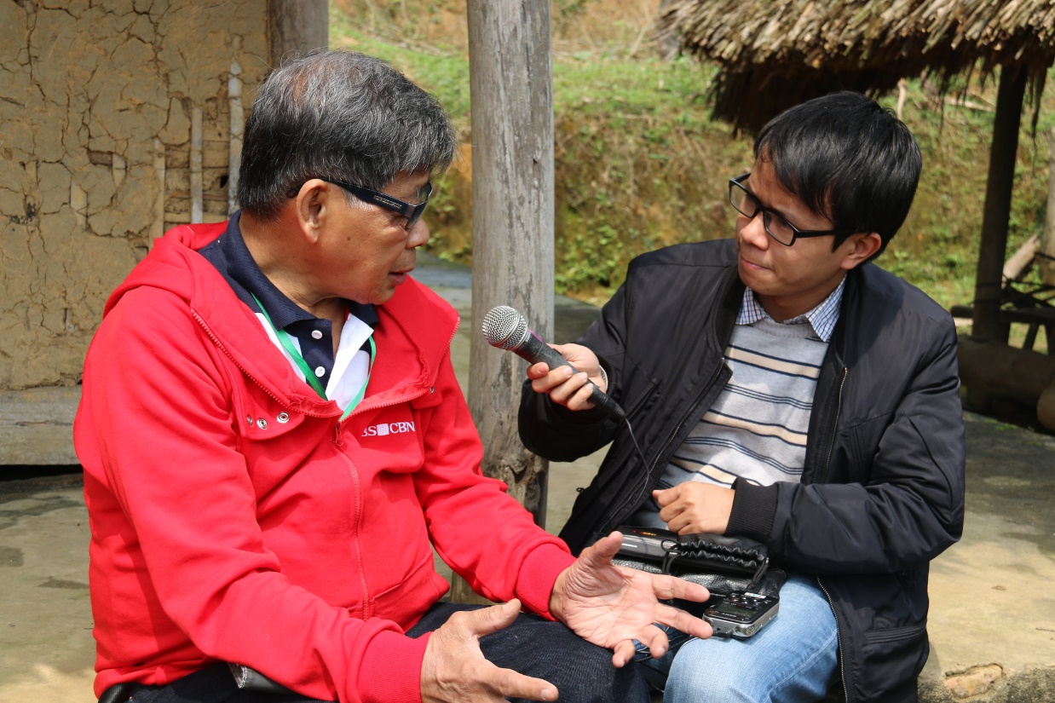
Emic vs etic perspective
Emic and etic are both types of anthropologic field research
Emic
Etic

Slide 4
purpose of using the emic perspective
Purpose of the emic perspective
Allows us to construct what’s underneath “the iceberg” and how it could make sense for someone from a different culture to behave in a particular way
A way to grant legitimacy and validity to other cultural viewpoints and norms.

Slide 5
How to get an emic perspective
How to get an emic perspective on a culture
Immerse yourself without being disruptive.
Learn the local language, jargon, lingo, etc.
Listen to individuals within the culture and let them share their stories without judgment.
Build a rapport with individuals within the culture by getting to know them and their beliefs, values, customs, and norms.
Question your assumptions about people’s motivations, beliefs, etc.
Ask questions about the hidden culture that is driving the more visible culture
Write thick descriptions of what you experience and observe

Slide 6
emic perspective Examples
Example 1:
Xue and Kerstetter (2019) use an emic approach to understand how residents in Chongdu Valley, China have adapted to rural tourism as their main form of livelihood when it had previously been agricultural. The residents described a period of culture shock when they first began making the transition, difficulty in overcoming cultural barriers between themselves and the tourists, and a period of adaptation where they had to modify their everyday lives/norms to accommodate this livelihood.
How does the local perspective shine through in this case?
What would be the challenge to researchers in coming to understand this local perspective?
Xue, L., & Kerstetter, D. (2018). Rural tourism and livelihood change: An emic perspective. Journal of Hospitality & Tourism Research, 43(3), 416-437. https://doi.org/10.1177/1096348018807289

Slide 7
emic perspective Examples
Example 2:
Kaur Mehar Singh (2019) investigates lecturers’ perspectives on why international graduate students in Malaysia often have difficulties with academic writing. The lecturers seemed to suggest that the students’ writing challenges stem from their lack of proficiency with the English language in general, as well as a lack of resources to get further help.
Whose emic perspective is represented here? Why does that matter?
Who else’s emic perspective might have been useful here?
Kaur Mehar Singh, M. (2019). Academic reading and writing challenges among international EFL master’s students in a Malaysian University: The voice of lecturers. Journal of International Students, 9(4), 972-992. http://doi.org/10.17576/gema-2016-1603-06

Slide 8
emic perspective Examples
Example 3:
Picture where you live.
How might a stranger describe that space from an etic perspective?
How would you prefer them to understand it from an emic perspective?
Notes:
If participants are having trouble coming up with examples, the facilitator might mention some possible options for both etic and emic.
Etic: Evaluating the condition and value of the home, comparing it to their own home, discussing the layout or the decor, identifying the number of rooms, etc
Emic: The traditions/everyday rituals that happen in the home, meaningful events that occurred in the home, etc.

Slide 9
Debrief
Debriefing Questions:
How might an emic perspective help you in your diverse, local community when traveling to an unfamiliar local context?
Which of the strategies from slide 5 might the most challenging for you and why?
An emic perspective is important, but there are also risks and limits to its use. What might some of these be?
Notes:
On the final question, if learners don’t generate ideas, you might bring up the risk of generalizing one emic perspective to be that of all people who belong to a particular community; the fact that as an observer, no matter how careful you are, you may influence the emic perspective offered without realizing it, and the fact that it is impossible to shed an interpretive lens even in the selection of quoting someone.

